Slide 1
From Algorithm to the Clinic: A Preference-Aware CDS for Shared Decision Making
Team HAC

Slide 2
Roadmap (1/1)
Research Question – Why are we doing this?
Conclusions
Data Exploratory – EDA drives design
Key methodology – How pipeline supports doctor’s decision?
Clinical Usage – How does this fit into real clinical practice?
Prototype – How CDS look like?
Decision Framework – How we provide recommendations

Slide 3
We would like to thank the authors of the papers referenced in this study.
Athey, S., & Wager, S. (2021). Efficient policy learning. arXiv. https://doi.org/10.48550/arXiv.1702.02896
Bach, K., et al. (2019). Design of a clinician dashboard to facilitate co-decision making in the management of non-specific low back pain. Journal of Intelligent Information Systems, 53(1), 167–189. https://doi.org/10.1007/s10844-018-0540-6
Broekhuizen, H., IJzerman, M. J., Hauber, A. B., & Groothuis-Oudshoorn, C. G. M. (2017). Weighing clinical evidence using patient preferences: An application of probabilistic multi-criteria decision analysis. PharmacoEconomics, 35(2), 259–269. https://doi.org/10.1007/s40273-016-0467-z
Butler, J. L. (2016). Using patient preferences to estimate optimal treatment strategies for competing outcomes (Doctoral dissertation, University of North Carolina at Chapel Hill). Carolina Digital Repository. https://doi.org/10.17615/8p58-pf19
Dakin, H., et al. (2018). Mapping to estimate health-state utility values: A systematic review of development and reporting practices. Medical Decision Making, 38(7), 894–905.https://doi.org/10.1177/0272989X18792737
Fusiak, J., Sarpari, K., Ma, I., Mansmann, U., & Hoffmann, V. S. (2025). Practical applications of methods to incorporate patient preferences into medical decision models: A scoping review. BMC Medical Informatics and Decision Making, 25, 109.https://doi.org/10.1186/s12911-025-02945-5
Lenert, L., et al. (2014). A model to support shared decision making in electronic health records systems. Medical Decision Making, 34(8), 987–995. https://doi.org/10.1177/0272989X14550102
Pöyhönen, M., & Hämäläinen, R. P. (1997). On the convergence of multiattribute weighting methods (Systems Analysis Laboratory Research Report). Helsinki University of Technology.
Romero-Brufau, S., et al. (2020). Implementation of artificial intelligence–based clinical decision support to reduce hospital readmissions at a regional hospital. JMIR Medical Informatics, 8(7), e16308. https://doi.org/10.2196/16308
Weyant, C., & Brandeau, M. L. (2021). Personalization of medical treatment decisions: Simplifying complex models while maintaining patient health outcomes. Medical Decision Making, 41(7), 783–796. https://doi.org/10.1177/0272989X211037921

Slide 4
Research Question (1/1)
How can we transparently combine predicted outcomes and patient preferences to support shared decision making in clinical practice?

Slide 5
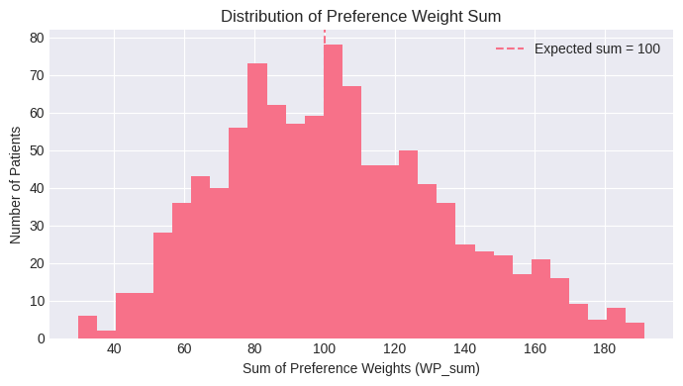
Data Exploratory (1/3)
Implication: Patients did not consistently allocate exactly 100 “chips”
Issue: Bias results, as patients with higher totals would disproportionately influence the decision score
Solution: Preference weights were normalized to sum to 100

Slide 6
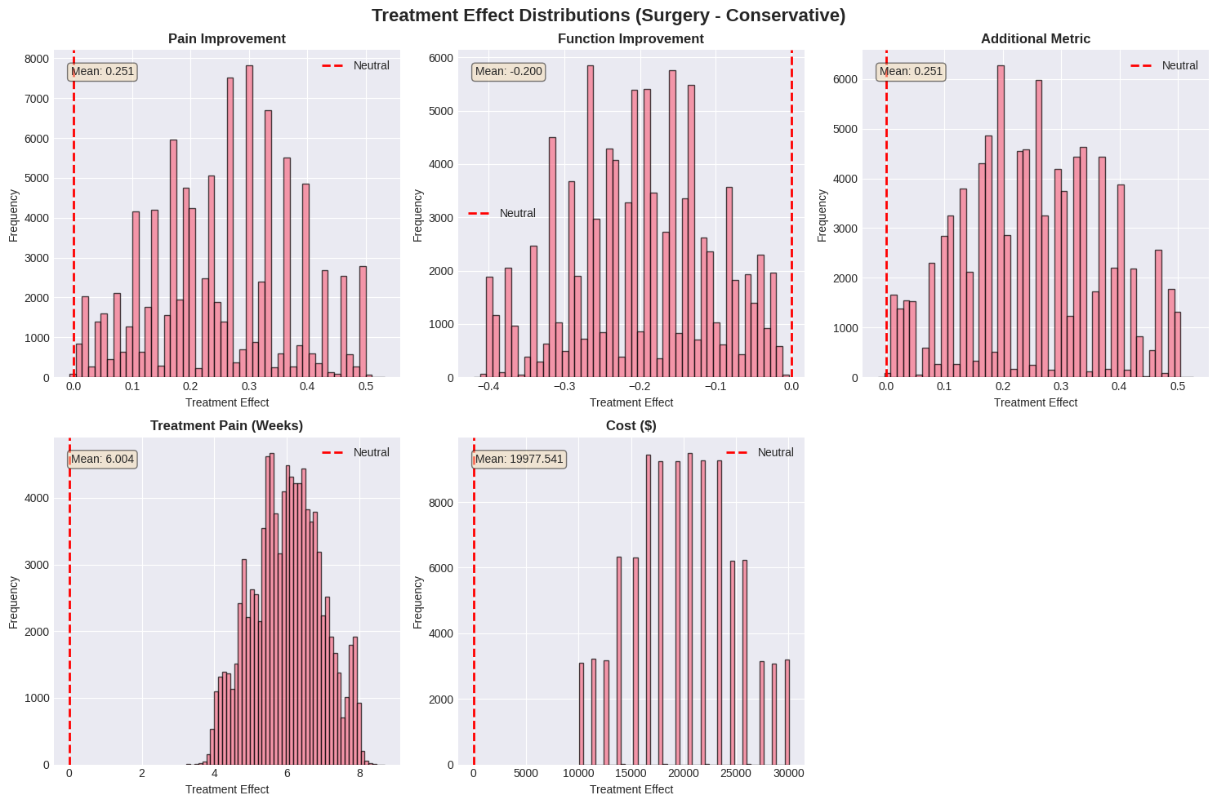
Implication (2/3)
Implication: Outcomes use different definition and scales, so raw treatment effects are not comparable. Solution: Align directions and normalize before aggregation.
Implication: Heterogeneity and preference sensitivity create many borderline cases. Solution: Use individualized effects, a decision margin, and flag cases for SDM.

Slide 7
Implication (3/3)
Implication: The five outcomes use different units (scores, weeks, dollars), so raw treatment effects can’t be compared or added fairly.
Solution: Convert all effects to a common dollar-value scale (after aligning benefit direction), then combine them using normalized patient preference weights.

Slide 8
Decision framework (1/2)
1️⃣ Preference-Weighted Utility
Key Idea: Decisions should reflect both predicted outcomes and patient values.
Weyant & Brandeau (2021), Medical Decision Making
Framework Implementation:
→ Combine predicted treatment effects with patient-specific preference weights to compute utility differences (utility = outcomes × preferences).
2️⃣ Outcome Normalization
Key Idea: Outcomes on different units cannot be combined directly.
Drummond et al. (2015), Methods for the Economic Evaluation of Health Care Programmes
Framework Implementation: → Align outcome directions and apply scaling/normalization before aggregation.
3️⃣ Patient-Specific Treatment Effects
Key Idea: Population averages may mislead individual treatment decisions. Kent et al. (2018), Annals of Internal Medicine
Framework Implementation: → Base recommendations on individualized treatment effects (CATEs) rather than average effects.
4️⃣ Borderline Decisions & SDM
Key Idea: Decision support should surface uncertainty, not hide it.
Elwyn et al. (2012), BMJ
Framework Implementation: → Apply a decision margin and explicitly flag borderline cases to support shared decision making.

Slide 9
Decision framework (2/2)
Estimate Treatment Effects
Patient-specific outcomes for Surgery vs Conservative
Apply Patient Preferences
Weight outcomes using WP1–WP5
Compute Utility Difference
ΔU = Surgery − Conservative
Decision Rule
Sensitivity Check
Recommend | Borderline | Trade-offs | Defer to SDM
Flag preference-sensitive cases

Slide 10
Key Methodology (1/4)
How:
Set WTP anchors (from health system research):
Long-term pain: $25,000
Treatment-related pain: $15,000
Function: $25,000
Convert TE → $ value per outcome
TE1 → pain_improvement_value = TE1 × $25k
TE2 → function_improvement_value = TE2 × $25k
TE3 → additional_quality_value = TE3 × avg($25k, $25k)
TE4 (weeks) → treatment_pain_cost = −(TE4/52 weeks) × $15k
TE5 ($) → direct_cost = −TE5$
OutcomeScaler (WTP-Based Outcome Scaling)
Why: Converting to $ value makes trade-offs comparable and easy to interpret.

Slide 11
Key Methodology (2/4)
How:
Input per patient
Treatment effects row TE1–TE5
Preference weights WP1–WP5_normalized
Scale outcomes
Returns dollar-value outcomes (positive = surgery better)
Apply preference weights
Convert each weight from % to decimal: weight = WP_normalized / 100
Multiply: contribution = weight × outcome_value
Sum contributions → total utility
total_utility = Σ contribution_k
Also store a breakdown of each component (weight, value, contribution) for explainability
Preference-Weighted Utility Integration
Why: We need a consistent way to turn patient preferences + outcome values into one transparent decision score.

Slide 12
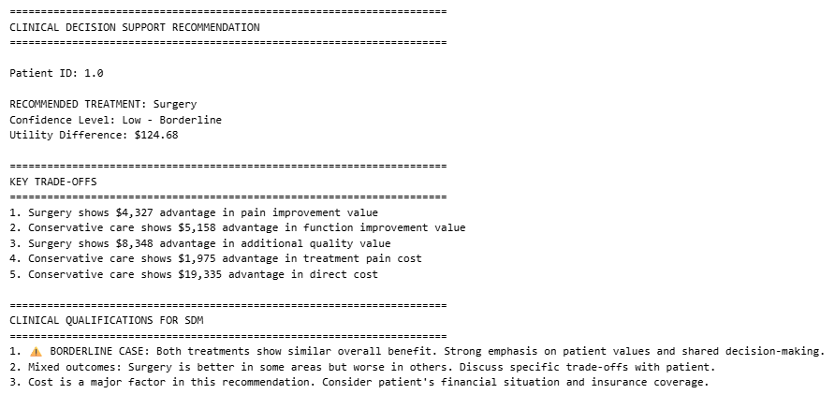
Key Methodology (3/4)
Utility-Based Treatment Recommendation
How:
If total_utility > 0 → Surgery; else → Conservative
Use utility magnitude to flag borderline cases
Compute abs_utility = |total_utility|
If < $2,000 → Low (Borderline)
If < $4,000 → Moderate
Else → High
Surface key trade-offs and cost considerations for shared decision making
Why: Translate utility scores into clear, actionable recommendations with confidence.

Slide 13
Key Methodology (4/4)
How:
Compute the base recommendation and utility score
For each WPk: increase it by +20%, reduce others proportionally, then renormalize to 100
Recompute recommendation
Mark as stable if no variation changes the treatment decision
Preference Sensitivity Analysis
Why: Check whether the recommendation is stable or changes when patient preferences shift.

Slide 14
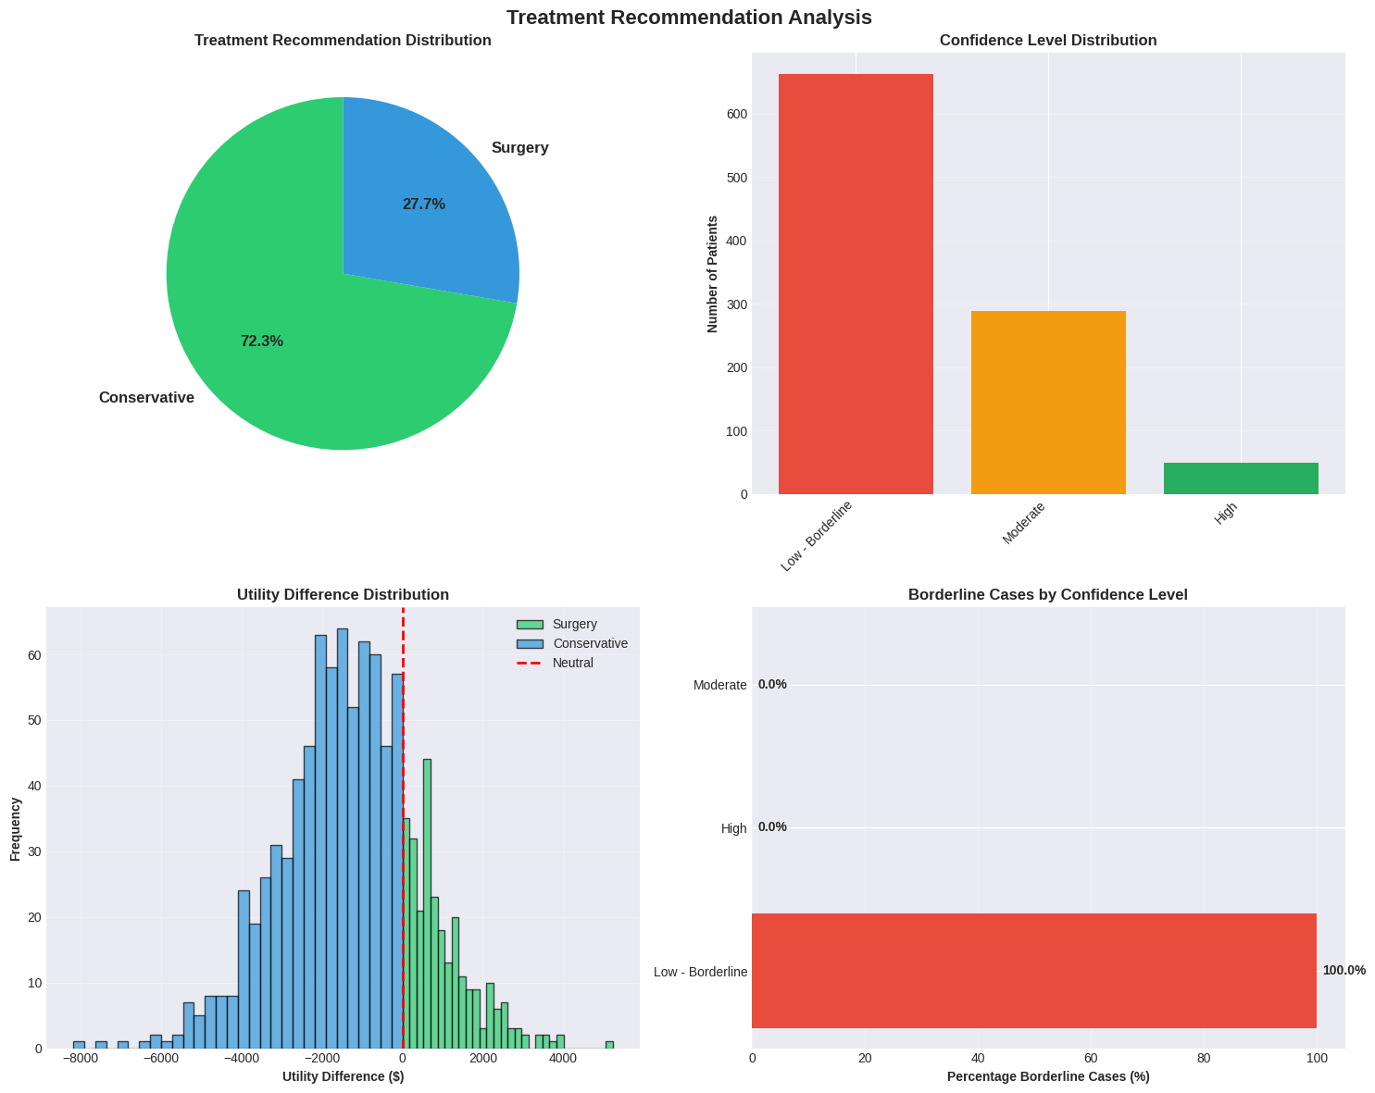
Predicted Outcome (1/1)
Conservative care dominates: ~72% of patients are recommended non-surgical treatment.
Many borderline cases: Most decisions lie near the threshold, indicating the need for shared decision making.
Clear cases are few: High-confidence recommendations are rare but decisive when present.

Slide 15
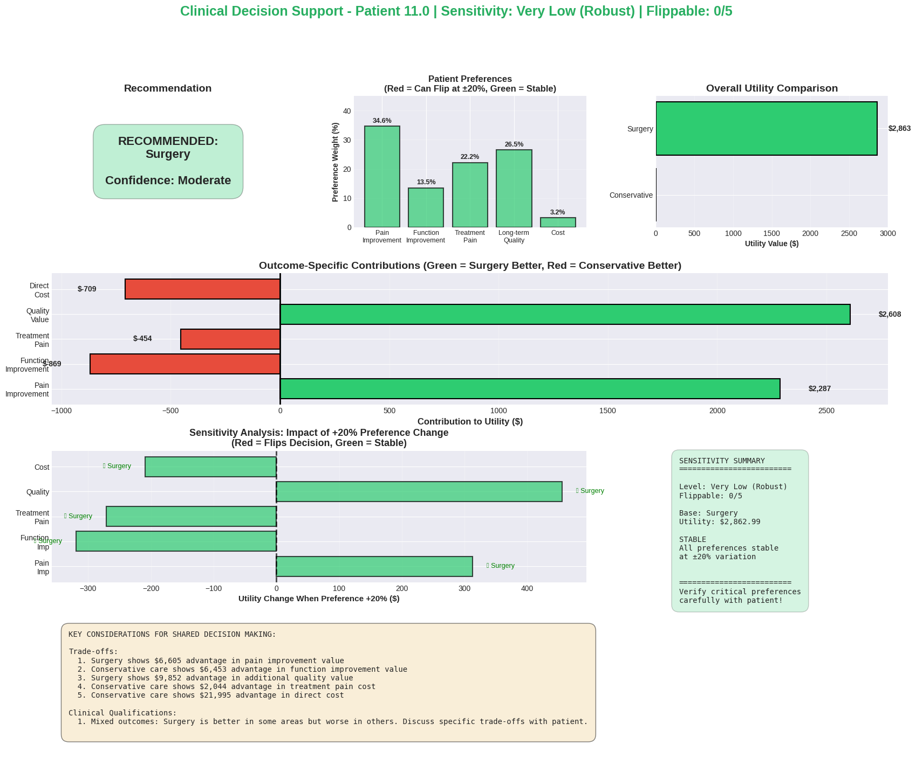
Prototype (1/2)

Slide 16
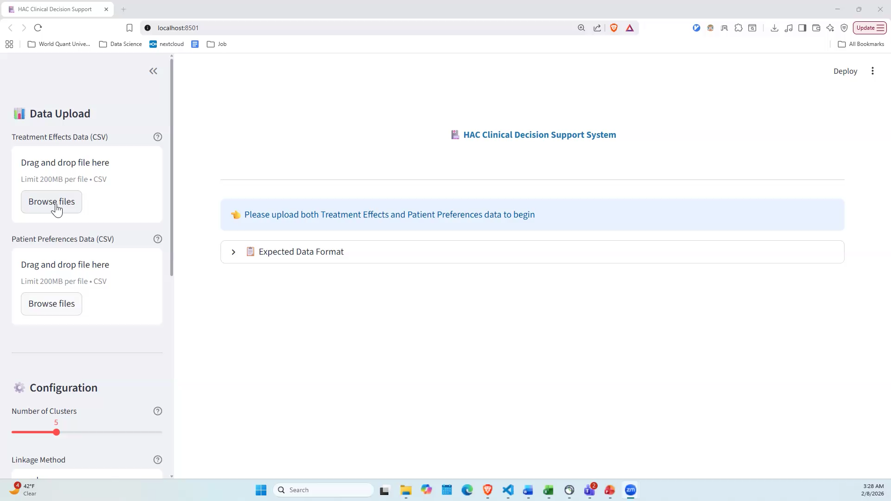
Prototype (2/2)

Slide 17
Clinical Usage (1/2)
Start with predicted patient outcomes For each patient, we estimate how surgery vs conservative care would change: long-term pain, short-term pain, function, rehab time, and out-of-pocket cost.
Put everything on the same scale Because these outcomes use different units, we convert them into a common dollar-value scale (so we can compare “pain relief” vs “time” vs “cost” fairly).
Apply what the patient values most Patients assign priority points to the five outcomes. The tool uses those priorities to weight the outcomes.
Compare the two options The CDS sums the weighted values into a single score:
If the score favors surgery → recommend Surgery
Otherwise → recommend Conservative care
Show confidence and trade-offs The CDS flags borderline cases (small difference) and lists which outcomes drive the result, so you can discuss trade-offs with the patient.
Check stability We test whether the recommendation changes if patient preferences shift slightly—if it flips easily, we label it sensitive, meaning the decision depends strongly on preferences.
Explanation to Doctor

Slide 18
Clinical Usage (2/2)
When to use: At the treatment discussion visit (after diagnosis and baseline assessment) to compare surgery vs conservative care for that patient.
What it provides: A patient-specific summary of expected differences across pain, function, rehab time, and cost—plus a recommendation and confidence level.
How to use in the visit: Review the trade-offs (what improves vs what worsens). If borderline/low confidence, treat it as a shared decision case—ask the patient what matters most and confirm preferences.
Use the output to document: “Recommendation aligns with patient priorities” or “Patient chose differently after discussion.”
Safety check: If the recommendation is sensitive (flips with small preference changes), emphasize that the decision depends heavily on values and revisit preference weights.
Note for Doctor

Slide 19
Conclusion
By combining predicted effects with patient preferences on a common value scale,
our CDS provides transparent, patient-centered recommendations to support—not replace—clinical judgment.

Slide 20
Thank you

